Slide 1
Chapter 7. Small-signal admittance
We will study the small signal response of the pn junction diode. A small ac signal (v_{a}) is superimposed on the DC bias. This results in ac current (i). Then, admittance Y is given by:
Y = i / v_{a} = G + jωC
Specifically, the following parameters will be studied:
Reverse bias junction or depletion layer capacitance
Forward bias diffusion or charge storage capacitance
Forward and reverse bias conductance.

Slide 2
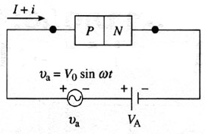
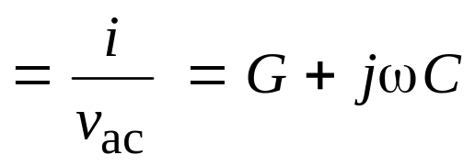
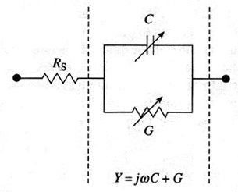
Capacitance measurements
I = DC
i = ac
Y = admittance
i and v_{a} depend on the applied DC bias
Model for a diode under ac

Slide 3
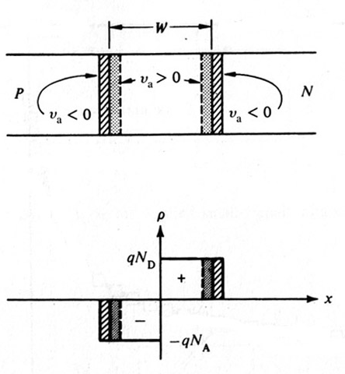
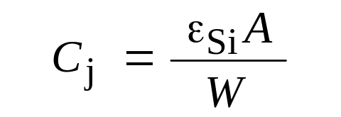
Reverse bias junction capacitance
A pn junction under reverse bias behaves like a capacitor.
Such capacitors are used in ICs as voltage-controlled capacitors.
Depletion layer width under small ac superimposed on DC bias voltage.
Looks similar to a parallel plate capacitor.
where W is the depletion-layer width under DC bias.

Slide 4
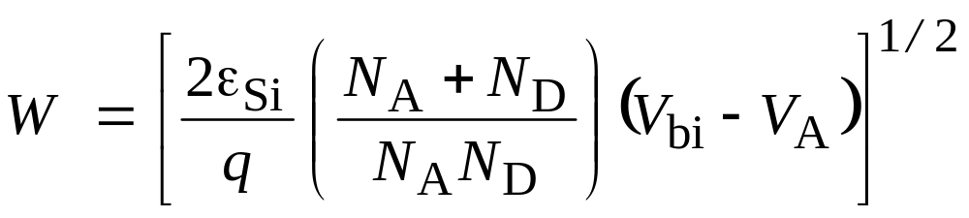
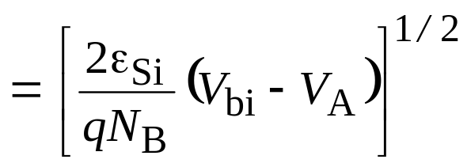
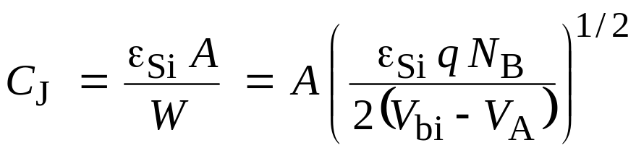
Reverse bias junction capacitance
For pn junction
For p⁺n or pn⁺ junction where N_{B} is the doping on the lightly doped side
For asymmetrically doped junction
C_{J} increases with N_{B}^{1/2}
C_{J} decreases with applied reverse bias

Slide 5
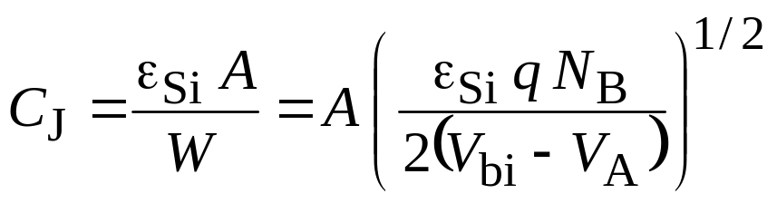
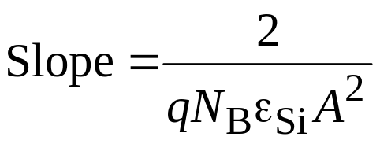
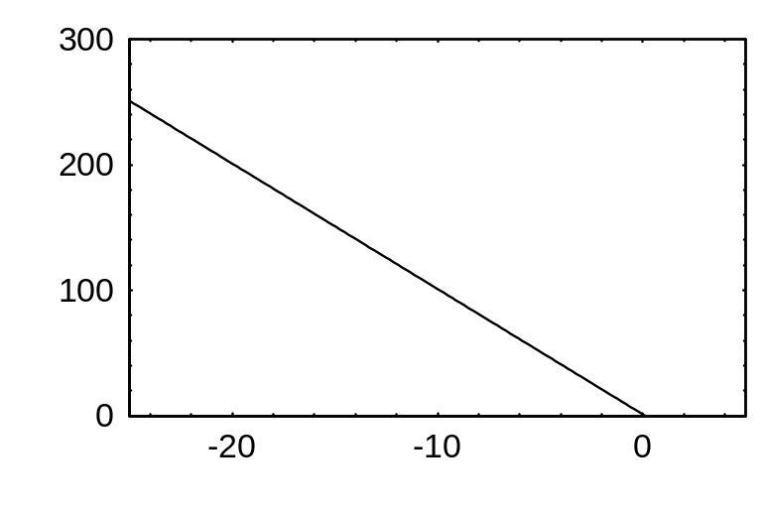
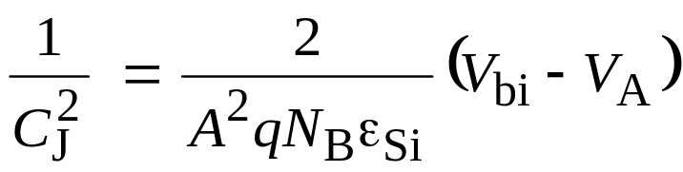
Parameter extraction/profiling
C-V data from a pn junction is routinely used to determine the doping profile on the lightly doped side of the junction.
2
1/C_{j}²
[F^{–2} ]
1
If the doping on the lightly doped side is uniform, a plot of 1/C_{J}² versus V_{A} should be a straight line with a slope inversely proportional to N_{B} and an extrapolated 1/C_{J}² = 0 intercept equal to V_{bi}.
0
–10
–5
0
V_{A} [Volts]
Intercept = V_{bi}

Slide 6
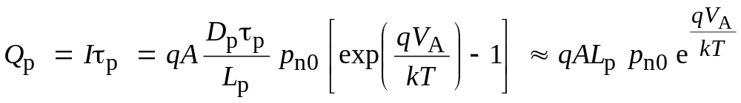
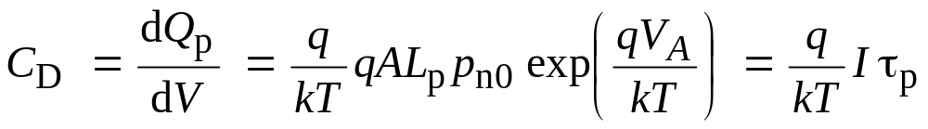
Forward bias diffusion capacitance, C_{D}
C_{D} is also called the charge storage capacitance. The variation of the injected minority-carrier charge, which is a function of the applied bias, results in the diffusion capacitance. Both C_{J} and C_{D} are always present, but for the forward-bias case, C_{D} becomes dominant.
p-type
n-type
Origin of diffusion
capacitance
n_{p0}
p_{n0}
x
For a p⁺n junction, I = Q_{p}/τ_{p} where Q_{p} is total excess charge in n-side

Slide 7
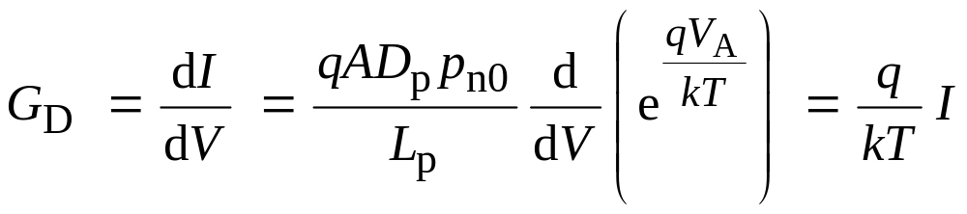

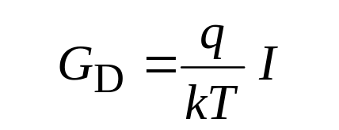
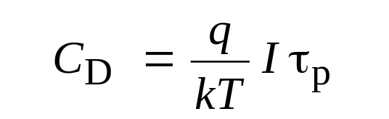
Forward bias conductance
Assumes
Complicated at higher frequencies.
V_{Applied} = V_{A}
C_{J}
R_{s}
C_{D}
Equivalent circuit for a diode
G_{D}
V_{J}

Slide 8
Example
Problem: Consider a p⁺n junction forward biased such that the forward current is 1 mA. Assume the lifetime of holes is 10^{–7} s. Calculate the diffusion capacitance and the diffusion resistance.
Solution: C_{D} = 3.86 nF r_{d} = 1/G_{D} = 25.9 Ω
The current through the depletion layer will mostly be carried by (holes, electrons: choose one)?
Plot the current carried by the holes and electrons through the n-type region, assuming that the diffusion length of holes is 1 μm.

